Slide 1


Can you ?

Slide 2
Tell them what you’ll tell them...
Introduction
What’s the big problem to solve?
What’s disruptive about Digital adoption platforms?
What does the user experience look like?
How easy is it to create such content?
Summary
Q&A

Slide 3

We have come a long way
Tablets to tablets!
Notes:
Introduce Whatfix
Team

Slide 4





What’s is the issue with traditional content?
Of users get to the end of a page
Of content on a page is read
Of all content gets less than 15 seconds of user time
Of all B2B content remains unread
10-20%
20%
55%
65%
Source : Nielsen
Notes:
Other depressing data
Only 15% of users adopt your application
70% of training is lost from the time it is delivered till the point of use

Slide 5

Notes:
Analyze why your content is not being read in spite of the useful information it can provide

Slide 6

Attention Spans
Human attention spans - 12 seconds in 2000 to 8 seconds in 2013
Goldfish have it higher - at 9 seconds!
Notes:
Attention spans have reduced and are now lesser than that of a goldfish!

Slide 7

Help is not part of their everyday workflow
Notes:
Has to be a process
Has to be in time
Has to be contextual
Information

Slide 8
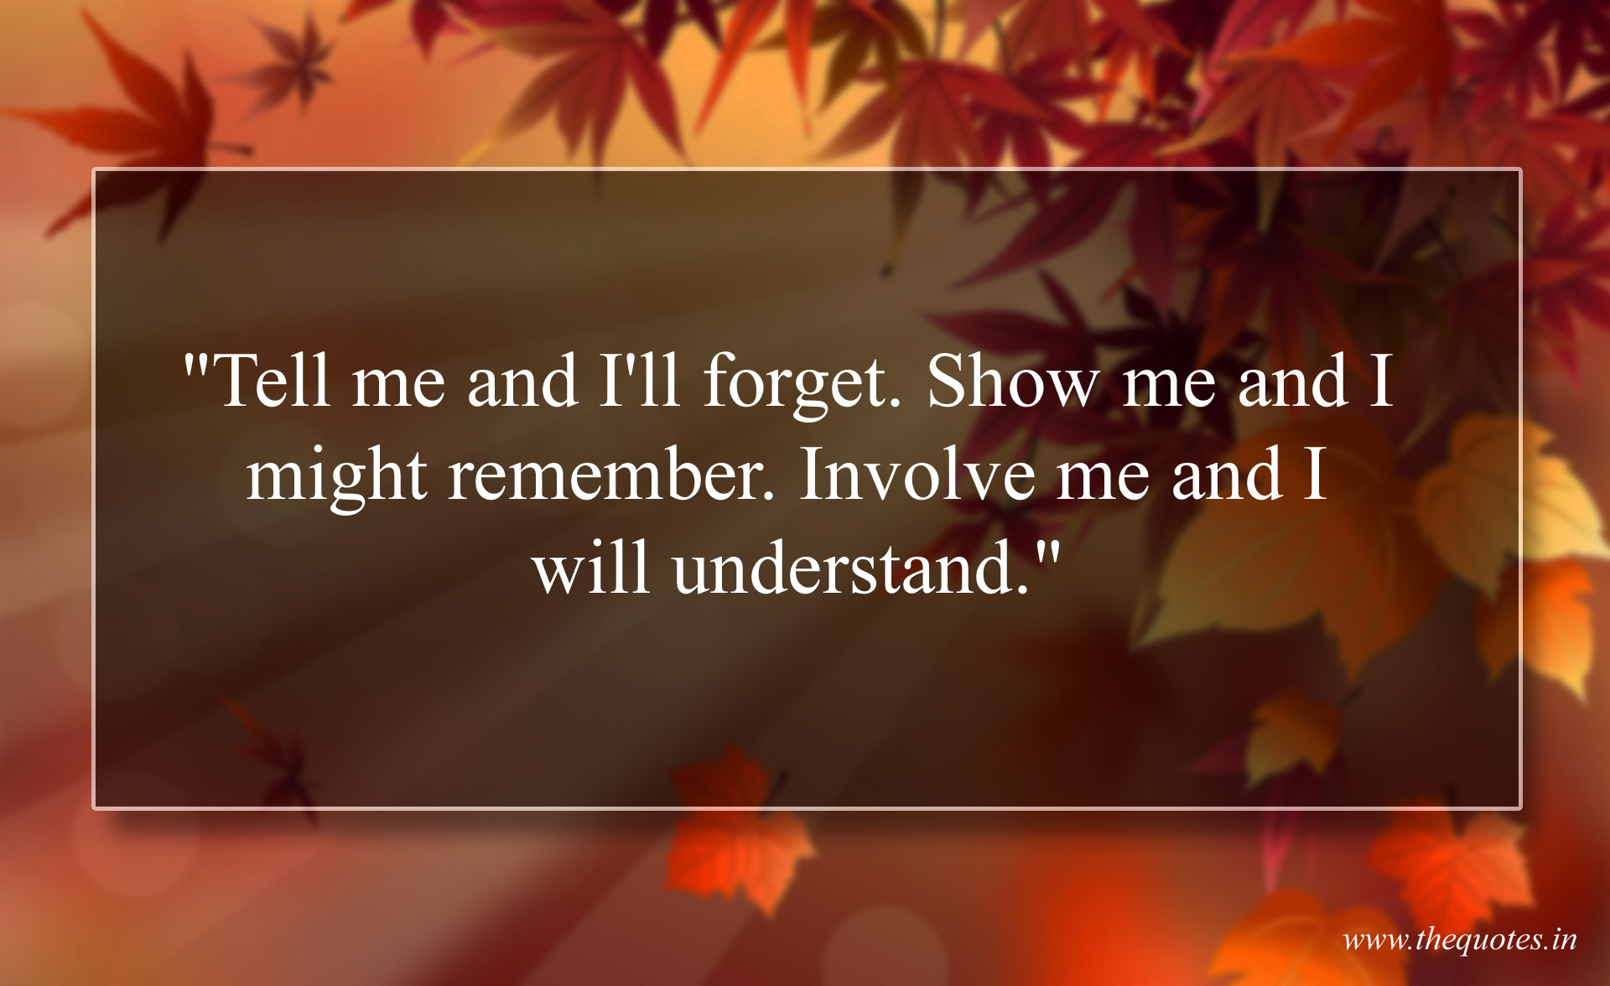
Our focus is not on - understanding
Source- http://thequotes.in/tell-me-and-ill-forget-show-me-and-i-might-remember-involve-me-and-i-will-understand/
Notes:
Content is static, not interactive.
Our focus in on content creation, not on consumption. For example, the reason many documents don’t have screenshots is that they become a nightmare when it comes to translation. Nightmare for whom?
All efforts on single sourcing focus on content creation. Not on the end user. Of course content is consistent. But what wins in the long run is that content is useful, more than being consistent.
Information overload

Slide 9

User Behavior
F-pattern
Screenshots facilitate scanning
Notes:
Keep the user at the center of your universe.
It’s not your convenience as an author that matters. Remember the audience!
Why do you create content? For whom?

Slide 10
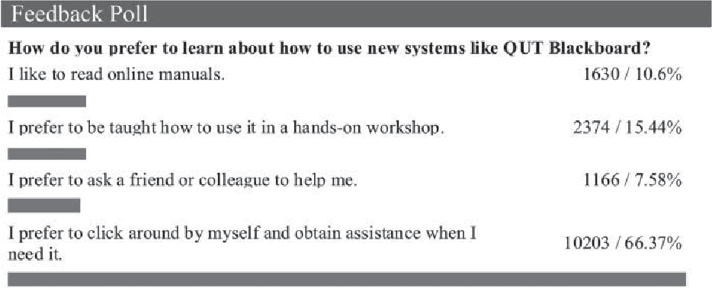
What do users prefer?
The results of a poll to university students and staff about how they used an LMS (2007)
Notes:
Remember the goldfish

Slide 11

Products are getting more complex
Rich Functionality
Product Experience
Notes:
As much as vendors try, functionality richness always trumps the experience. as products scale and cater to larger enterprise markets, complexity increases proportionately and the experience keeps dropping, in terms of users being able to intuitively use products and realize value as quickly as possible. that is also related to the overall ROI of products. as a buyer, you want to reach breakeven as quickly as possible but that doesn’t really happen for compex products. companies also want users to use products intuitively asap to drive business outcomes rather than spending business hours on learning and understanding how to use a product. so in that sense it’s a sort of paradoxical situation for a lot of products. and in a way the entire ecosystem of buyers and vendors understands this cycle, so they also kind of adjust to it. but that’s not ideal.

Slide 12

Build a better product!
The best content cannot make up for a poorly designed product
Notes:
Efforts to improve the product must continue. One of the ways is to look at ways by which you can eliminate the need for help.

Slide 13
So is there a solution?

Slide 14
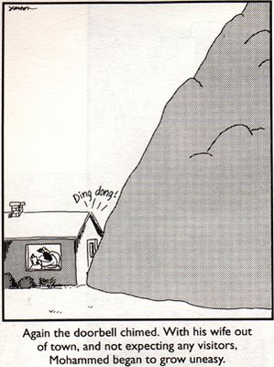
Bring the mountain to Mohammed
Source: http://kirwani.blogspot.com/2006/04/when-mountain-came-to-mohammed.html
Notes:
Moving on to Whatfix

Slide 15

Integrating Experiences
Single Integrated Experience
Contextual information is not new
Challenges with creation
Delink Help Creation from Development
Processes shouldn’t take more time than the change itself!
Contextual and Relevant
Low Maintenance Multiple Outputs
Content Aggregation
Intelligent content
Notes:
We can’t afford to have multiple experiences. A help experience and a product experience
Need a solution that can create a single experience
Ability to show relevant, contextual information at the point of need
Can’t afford to make iterative changes. Need a solution that can step in

Slide 16
Making Help a Verb again
How does Whatfix created content look like?
Analytics
Creating Whatfix content
How is it integrated and deployed?
Some features of Whatfix and use cases
Notes:
Introduction to Whatfix features
What’s automation doing for users?
How is intelligent segmentation making it easier to author content?
What’s the advantage of multi format outputs?
How Whatfix content is Scrom and xAPI compliant and the impact

Slide 17
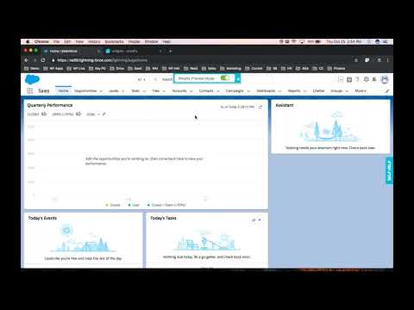
Demo
Watch a demo at https://www.youtube.com/watch?v=jBemvzqp0Ck&feature=youtu.be

Slide 18
Use Cases
Vestibulum congue
Onboarding
Vestibulum congue
Vestibulum congue
Continuous Training
Change Management
Your Product
Vestibulum congue
Vestibulum congue
Self Service Contextual Support
Form Field tips
Notes:
Content aggregation
Intelligent Segmentation
task list, beacon, pop ups
Scrom and XAPI

Slide 19
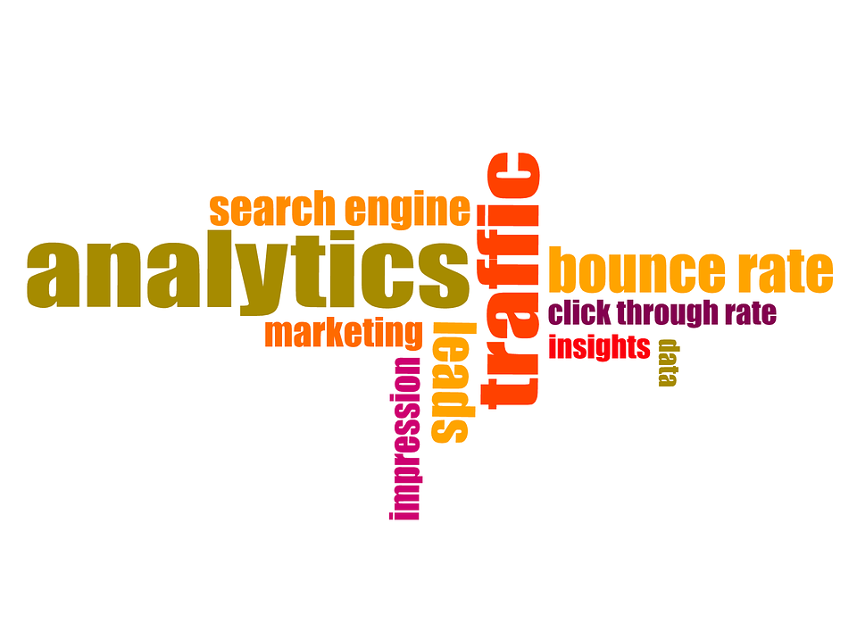
Analytics
Notes:
You cannot improve what you cannot measure!
Whatfix helps you measure the performance of your content.
Which walkthroughs are working? Where are users getting stuck? Which step? What are search phrases that don’t return results? Usage information

Slide 20


Time to Go-live with Whatfix
Just about two days to deploy and start using Digital Guidance with Whatfix!
Time to Deploy
Just ten minutes to get the first Digital Guidance content live and available to end users!
Time to Deliver
Notes:
Deployment and Integration methods
On cloud and Self Hosted

Slide 21
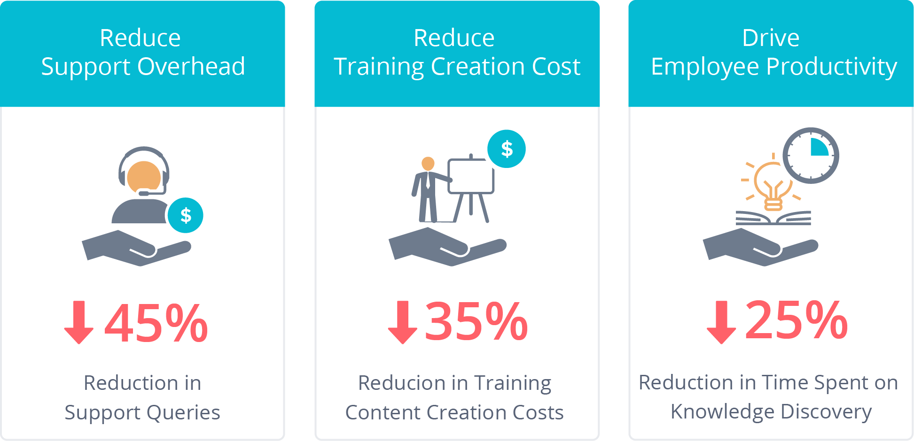
Impact of Implementing Whatfix
*Based on Customer Data and Feedback
Notes:
ROI of the Whatfix platform and how this impact is delivered.

Slide 22




























Who’s using Whatfix?
Healthcare
Retail
Services
Hi-Tech
Education
Finance
Travel
Global presence in 25+ countries and expanding...
Notes:
400 plus customers
One of the Fastest growing startup in India
40 of the fortune 500
End users and employees

Slide 23

It’s a skill!
Digital Adoption
Expert

Slide 24
Tell them what you told them :)
Why traditional content isn’t cutting it
What is a better product experience
How to create such experiences
Impact

Slide 25
References
https://www.nngroup.com/articles/how-little-do-users-read/
https://econsultancy.com/why-visitors-only-read-20-of-your-web-page/
https://hub.uberflip.com/blog/13-stats-that-prove-that-nobody-is-reading-your-content-and-what-you-can-do-about-it
https://medium.com/compassionate-coding/its-time-to-retire-rtfm-31acdfef654f

Slide 26


Q/A
nibu.thomas@whatfix.com
https://www.linkedin.com/in/nibu-thomas/
Notes:
Request for a demo or a trial

